Slide 1

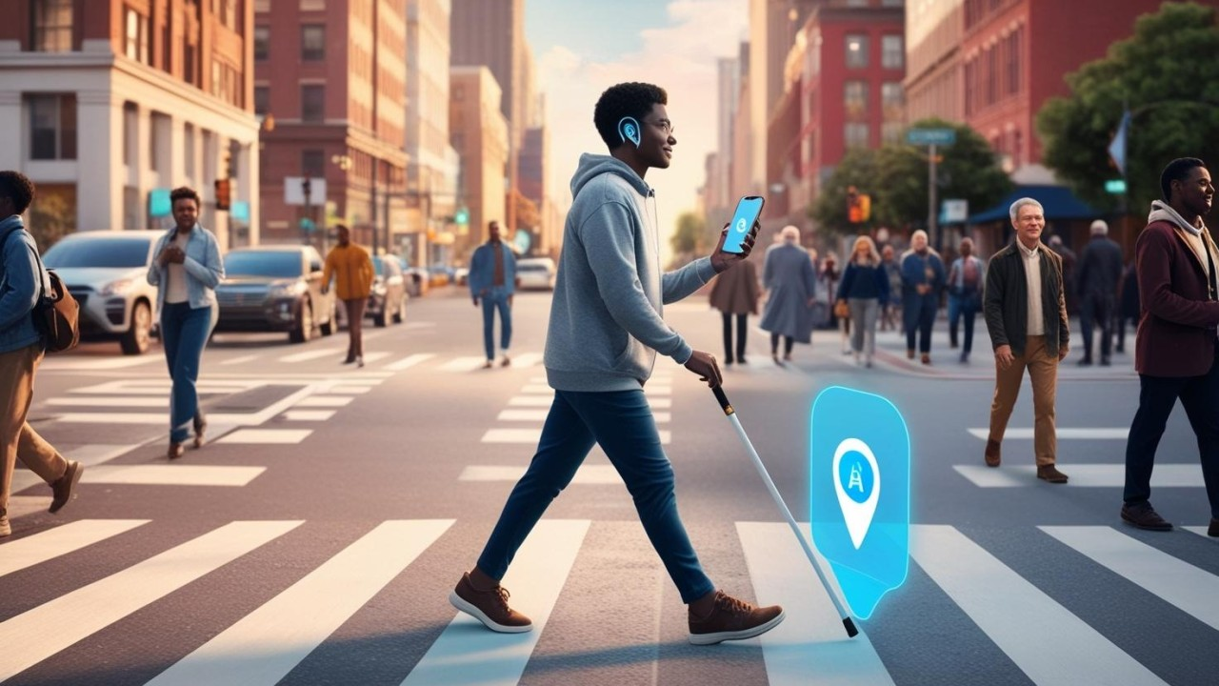



AI POWERED ASSISTIVE MOBILITY FOR VISUALLY IMPAIRED
Project Mentor: Purushothaman N

Slide 2

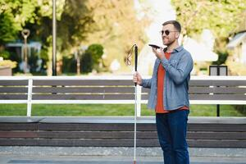

OVERVIEW OF THE PROJECT
Mobility for the visually impaired is often limited by unsafe paths and unseen obstacles.
Our AI-powered assistive system transforms ordinary navigation into a smart, safe, and independent journey.
By combining computer vision, real-time detection, and voice guidance, it bridges the gap between ability and accessibility.

Slide 3
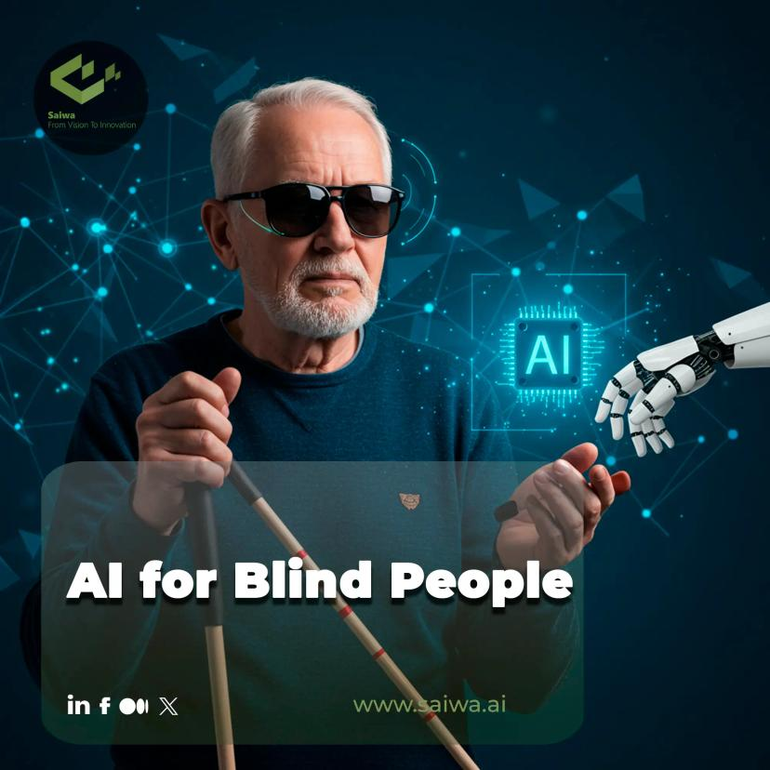
PURPOSE
To empower visually impaired individuals with safe and independent mobility.
To provide real-time obstacle detection and voice guidance.
To reduce reliance on traditional aids like canes.
To promote accessibility, confidence, and inclusivity in daily navigation.

Slide 4
TECHNOLOGY STACK
Computer Vision – YOLO for object detection & obstacle recognition
Backend Framework – Flask for real-time processing & integration
Frontend Interface – React for interactive user experience
Speech Technology – Text-to-Speech (TTS) for voice guidance
Sensors & Camera – Capturing real-world environment in real time
Python – Core programming language for AI and system logic

Slide 5
FEATURES
Real-time Obstacle Detection – Detects objects and hazards instantly
Voice Guidance – Provides spoken directions for safe navigation
Alert System – Notifies users of immediate dangers
Portable & User-Friendly – Easy to carry and operate anywhere
Scalable & Upgradable – Can integrate new sensors or AI models

Slide 6
METHODOLOGY
Data Capture – Cameras and sensors gather real-world environment data
Object Detection – YOLO model identifies obstacles and hazards in real-time
Backend Processing – Flask handles computations and decision-making
Voice Feedback – Text-to-Speech system provides immediate guidance
User Interaction – React frontend ensures simple and intuitive control
Continuous Improvement – System adapts with new data for accuracy

Slide 7
FUTURE ENHANCEMENTS
GPS Integration – Outdoor navigation with route optimization
Advanced AI Models – Better object recognition and predictive navigation
Multilingual Voice Support – Guidance in multiple languages
Cloud Data Analytics – Continuous improvement via usage data

Slide 8
CONCLUSION
The AI-powered assistive mobility system enhances safety and independence for visually impaired users.
Combines real-time detection, voice guidance, and smart navigation for effective mobility.
Offers a scalable and inclusive solution for daily challenges.
Paves the way for future innovations in accessible technology.

Slide 9
THANK
YOU

